Slide 1
外籍生及陸生宿舍登記程序
Procedures of dorm registration
1.進入資訊系統
1.Enter the Information Service website

Slide 2
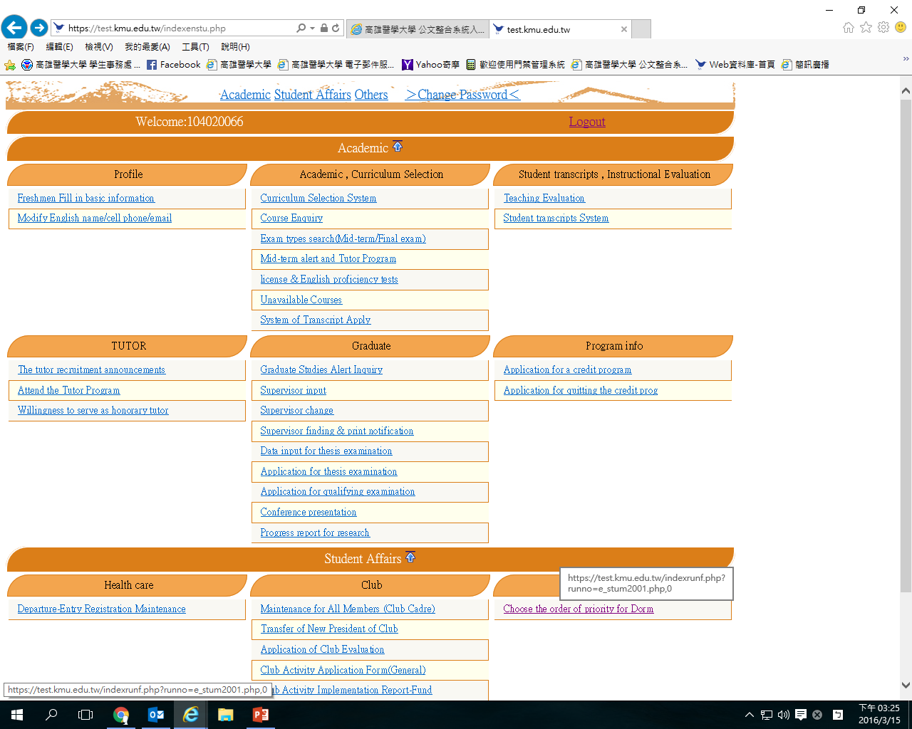
2.點選
2.Select

Slide 3
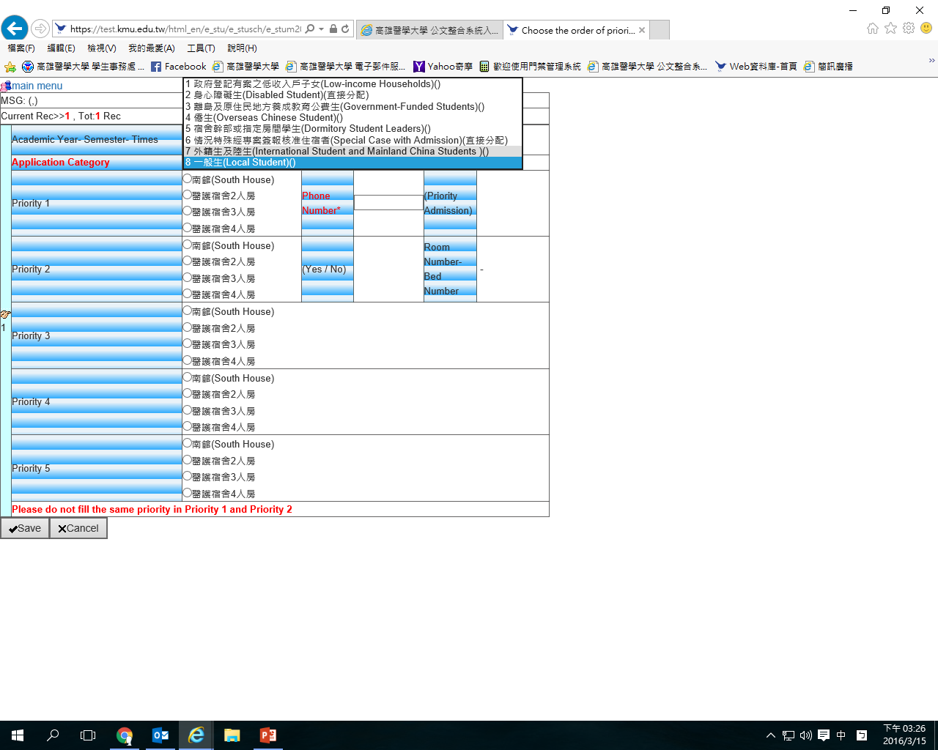
3.選擇身分別
3.Select the identity category

Slide 4
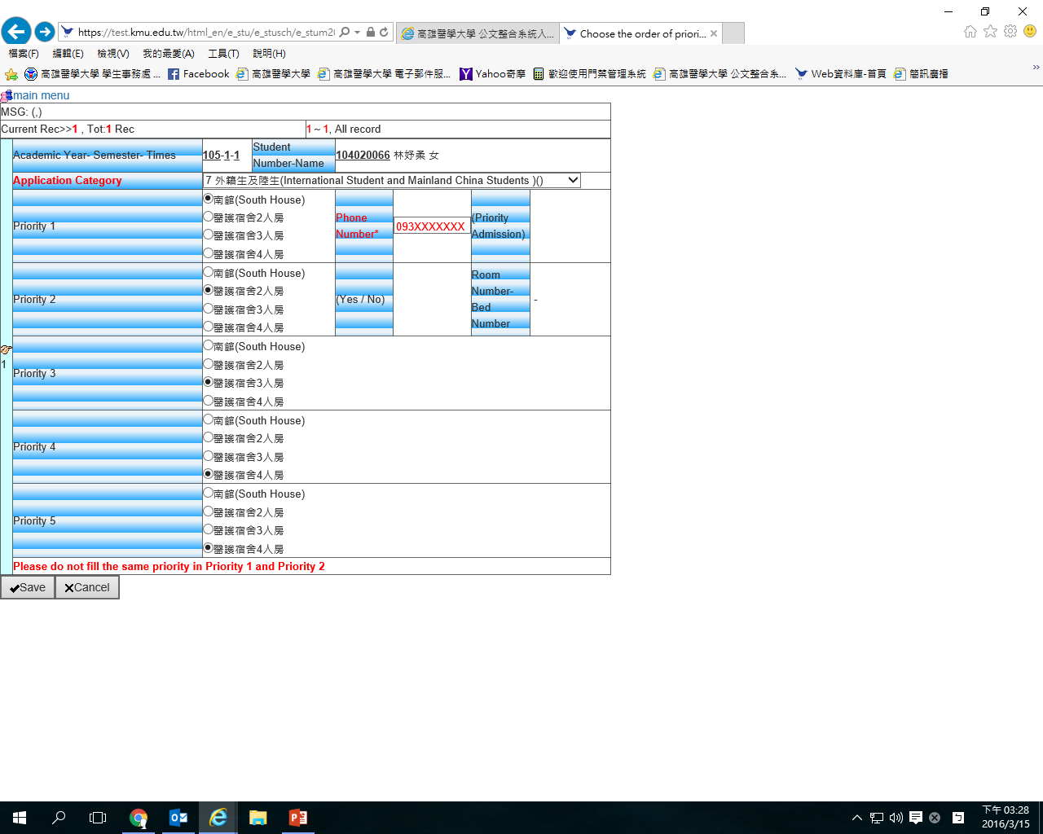
5.留下電話，便於聯絡
5.Leave your phone number for contact
4.選擇想要住的房型，共有5個選項，建議都選不一樣的，如果重複也沒關係
4.Choose your room type, please select 5 different options. It is fine if you repeat
6.按SAVE鍵存檔
6.Select the SAVE button

Slide 5
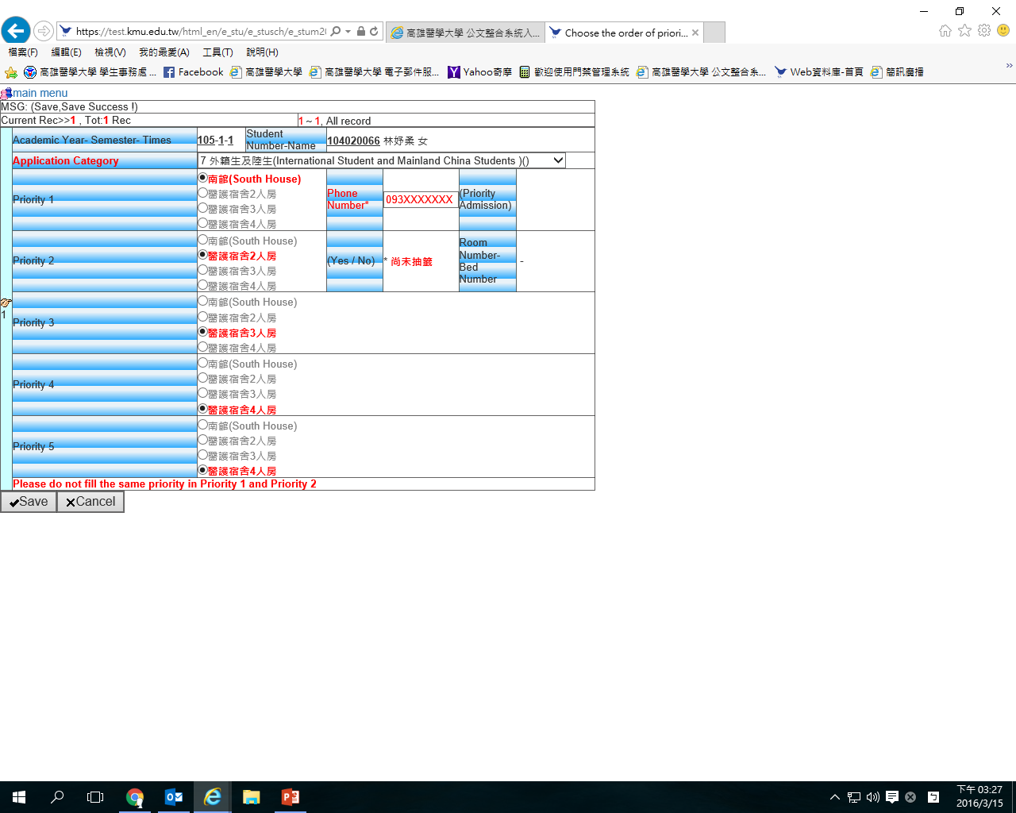
7.出現這種畫面才算成功
7.Application succeeded if this page comes out

